Slide 1
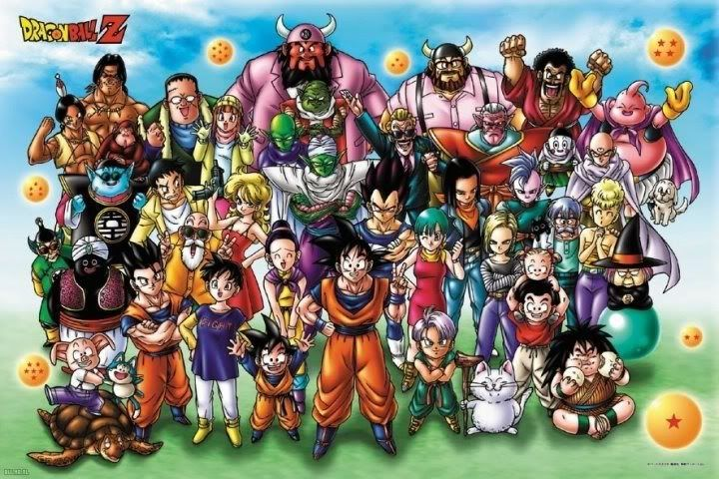
Top 7 Riddles of Dragon Ball Series
Composed By: Hayato Ishida
For Japanese version, click here
Updated On: 16 July 2024

Slide 2
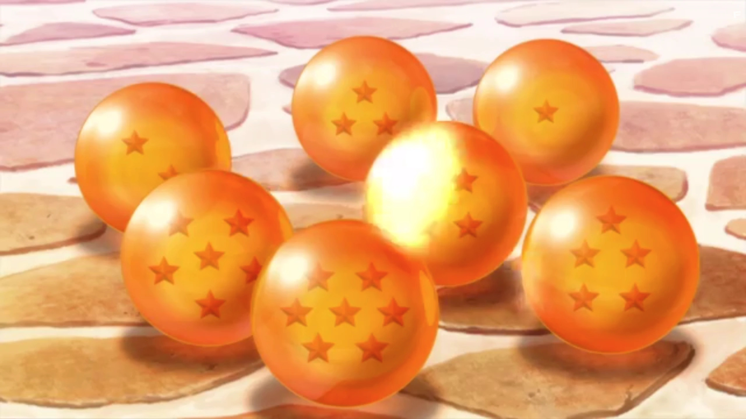

About Me
Accounts
GitHub: @hayat01sh1da
X: @hayat01sh1da
LinkedIn: @hayat01sh1da
Speaker Deck: @hayat01sh1da
Docswell: @hayat01sh1da
Occupation: Software Engineer
Things I Am Into
Linguistics
Singing at Karaoke
Listening to Music
Watching Movies
Cat Feeding

Slide 3
Licences / Certifications
English
TOEIC® Listening & Reading 915: Certified on December 2019
Engineering
Information Security Management: Certified on November 2017
Applied Information Technology Engineer: Certified on June 2017
Fundamental Information Technology Engineer: Certified on November 2016
IT Passport: Certified on April 2016
Others
Abacus 2nd Class: Certified on June 2002
Mental Arithmetic 3rd Class: Certified on February 2001

Slide 4
Skill Stack
Languages
Japanese: Native Proficiency
English: Full professional Proficiency
Development
Backend: Ruby(Ruby on Rails), Python
Frontend: TypeScript + React.js, TypeScript +Vue.js
Database: MySQL, PostgreSQL, MongoDB
Architecture: Monolith, Modular Monolith
Hosting: AWS ESK
Versioning: Git, GitHub
CI/CD: GitHub Actions, ArgoCD
Monitoring: Datadog, Sentry

Slide 5
Work Histories
Period | Genre | Position | Jobs
Aug 2021 - Present | Saas(Educational Service) | Software Engineer | Backend Development Frontend Development CI/CD Maintenance Weekly Release Manager Troubleshooting Documentation Technical Debt Resolution Tech Blog Entries LT Speaker
Feb 2020 - Dec 2020 | SaaS(Chatbot Platform) | Backend Engineer | Backend Development Documentation Technical Debt Resolution Inspection of Alternative API

Slide 6
Work Histories
Period | Genre | Position | Jobs
Jun 2018 - Jan 2020 | Contract-basis Developer | Software Engineer | Backend Development Frontend Development Troubleshooting Quality Assurance Tech Blog Entries
Apr 2016 - Jan 2018 | System Engineering Service | System Engineer | Corporate Account Admin Windows Server Maintenance Security Admin Assistant Internationalisation / Localisation

Slide 7
International-Exchange Activities
Activities in University
English Linguistics Seminar(Focusing on Mass Media English)
International-Exchange Clubs(The 2nd Year)
International-Exchange Programmes conducted by Japan Cabinet Office(2013 - 2016)
Japanese Linguistics Course(The Final Year)
Overseas Life Experience
Working Holiday in Australia(April 2014 - March 2015)
Language School for 1 month in Sydney
Work for 6 Months in Hamilton Island Resort
Volunteering for 1 Month as Assistant Teacher of Japanese Language at St Ives High School in NSW
Other Activities
Keep Everyday Journal in English (April 2014 - Present)
Sunrise Toastmasters Club(February 2017 - March 2018)
Vital Japan(January 2018 - July 2019, October 2022 - February 2023)
Self Learning and Training of English Language
Participation Ruby-Related Tech Conferences

Slide 8
Agenda
What Dragon Ball Series Are About
Top 7 Riddles of Dragon Ball Series
Summary

Slide 9
1. What Dragon Ball Series Are About

Slide 10
What Dragon Ball Is
Dragon Ball is a series of comics and anime which is rooted on A Journey to the West.
It describes a journey and battles for wonderful balls called Dragon Ball which realises any hope within the ability of the Creator if its 7 balls are collected and a specific spell is cast.
Its economic effect was so huge that the author, Akira Toriyama, wished to cease after the Frieza episodes, but the publisher did not allow it.
As a result, Dragon Ball became a long-running comic series, which led to loads of funny contradictions of settings in characters and situations.

Slide 11
The World of View
Currency: Z
Language: Japanese as a cosmopolitan language
Barometer of Strength
Battle Power: Scored by a device called Scouter
Goku: 10(Beginning) → 180(The 22nd World Martial Arts Tournament) → 260(vs. Great Satan Piccolo) → 334 - 416 - 924(vs. Radditz) → 8000 - 32000(vs. Nappa & Vegita) → 5000 - 90000 - 180000(vs. Ginyu Special Force) → 300万 - 1億5000万(vs. Frieza)
Kili: Scored by a device Dark Wizard Babidi has. Character who has 200 - 300 kilis is said to be able to destroy a couple of planets.
Goku: 3000 Kilis(Full Power Form of Super Saiyan 1)
Yakon: 800 Kilis

Slide 12
Species
Earthians
Humanoid Earthians: Kurillin, Yamcha, Master Roshi, Tenshinhan (Strictly not an Earthian but an offspring of Three-Eyed
Family) etc.
Animal Earthians: Hermit Karin, Male Wolf, Giran etc.
Humanoid Cyborg: No.8, No.17, No.18, No.20(Dr. Gero), Cell
No.13 - 15, No.16 and No.19 were manufactured from the scratch, so they are not counted as Earthian.
Aliens
Humanoid Aliens: Saiyans(Goku, Vegita, Nappa, Radditz etc.), Recoome
Non-Humanoid Aliens: Namekians(Piccolo etc.), Cui, Guludo, Dodoria etc.
Transformable Aliens: Frieza, Cooler, Zarbon
Demons
Said to be born in the Makyo Star, but there are some exceptions like Piccolo who is born and raised.
Their body is mature by born or incredibly quickly grow up.
Those killed by Deamons never become Buddha and keep wandering this world with pains
Humanoid species can bear children(e.g., Gohan, Goten, Trunks etc.). Humanoid Cyborg No.17 and No.18 were originally human, so they can too.

Slide 13
Forms of Saiyan
Normal Form: Z fighters can control battle power from 0 to the max power.
Super Saiyan 1:
The 1st Phase: Soon after awaken and excited. 50 times + stronger than the normal form.
The 2nd Phase: More powerful and speedier than The 1st Phase. More muscular and the aura intensely flashes like fire of a burner.
The 3rd Phase: Too muscular to move speedily at all.
Full Power: Used to The 1st Phase and stay calm. Can fully release the whole potential power with the best physical balance and the least physical damage.
Super Saiyan 2: 100 times + stronger than the normal form. More finely stand-up hair is distinctive. The aura is surrounded by sparks.
Super Saiyan 3: 400 times + stronger than the normal form. Longer hair and lost
eyebrows are typical. The aura is surrounded by sparks.
Legendary Super Saiyan: Only Broly can transform. Purely thirsty for bloods and wars.
Giant Ape: 10 times + stronger than the normal form. Royal Family members and elite fighters can keep their reasons.

Slide 14
2. Top 7 Riddles of Dragon Ball Series

Slide 15
Notes
[C] Commonly Described Both in Comics and Anime
[A] Described only in Anime

Slide 16
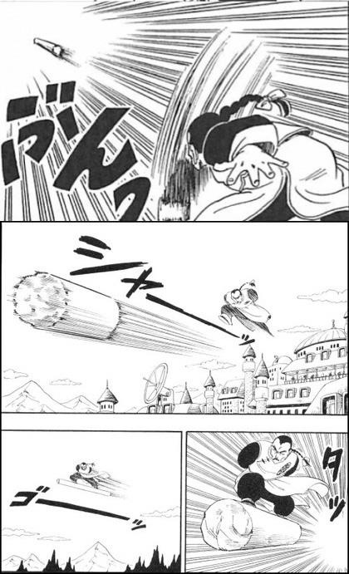
[C] No.1: Transport of Mercenary Tao
This character prefers to jump on a stone pillar to arrive at his destination, which is quite acrobatic. Theoretically, he could fly to the destination without the pillar because he can catch up with the so
fast-moving object that reaches to it.

Slide 17
[C] No.1: Transport of Mercenary Tao
The pillar is not needed,
is it?

Slide 18
[C] No.1: Transport of Mercenary Tao
However…
The weight of a human is not heavy enough to avoid air resistance and gravity, which is highly to lead to loss of the top speed on the way.
Therefore, such a heavy object as the pillar seems to work.

Slide 19
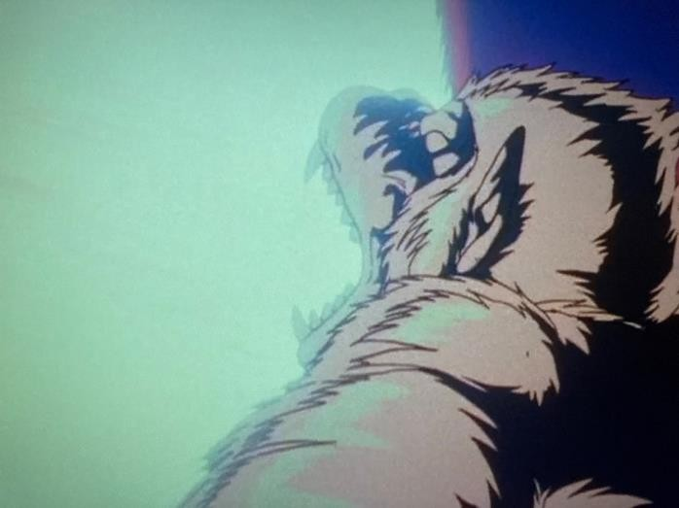
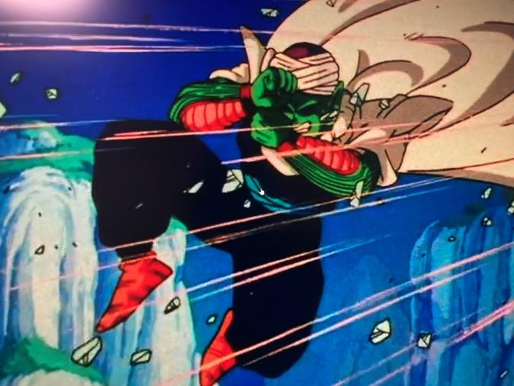
[C] No.2: Piccolo's Reaction to Gohan's Transformation to Giant Ape
After the battle against Radditz,
Piccolo imposed a mission to survive in a wildland
to prepare for harder battle against Nappa and Vegita. One night, Gohan accidentally stairs at the full moon and
transformed to a giant ape and Piccolo was surprised at it. However, Gohan's battle power was only 1 in his normal form without excitement of his emotion, so his battle power must have been only 10 even after the transformation.

Slide 20
[C] No.2: Piccolo's Reaction to Gohan's Transformation to Giant Ape
Piccolo is too weak,
isn't he?

Slide 21
[C] No.2: Piccolo's Reaction to Gohan's Transformation to Giant Ape
However…
This hypophysis is not official, but if the battle power of the giant ape form was 10 times stronger than the max power of the normal form, it would have been as high as 13070 because Gohan's max battle power was 1307 in the fight against Radditz.
Piccolo's battle power ranged from 408 to 1330 up to 1480 at the time, so Gohan could have been about 10 times stronger than Piccolo.
Piccolo was rather weak than lucky because he did not get injured at all.

Slide 22
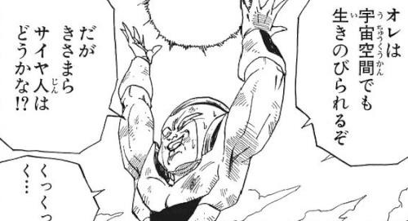
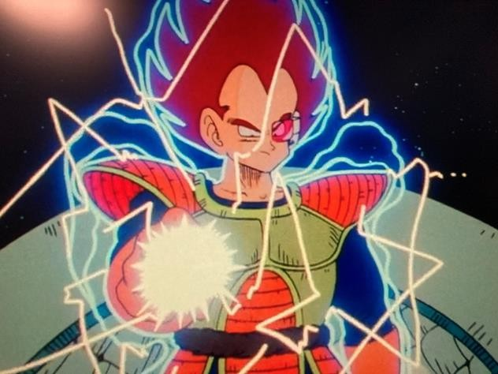
[A] No.3: Survival of Vegita in Space
According to Frieza,
Saiyan cannot survive in the cosmic space and the official setting also mentions it.
However, Vegita destroyed a ruined star on the way to the Earth from the cosmic space and fought against the remains of Frieza Force in the outer space.

Slide 23
[A] No.3: Survival of Vegita in Space
Does Frieza and the official setting are fake?

Slide 24
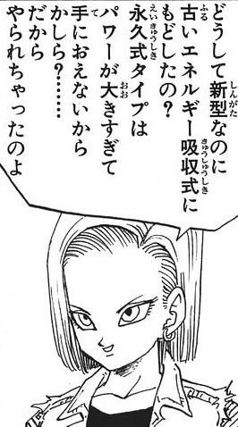
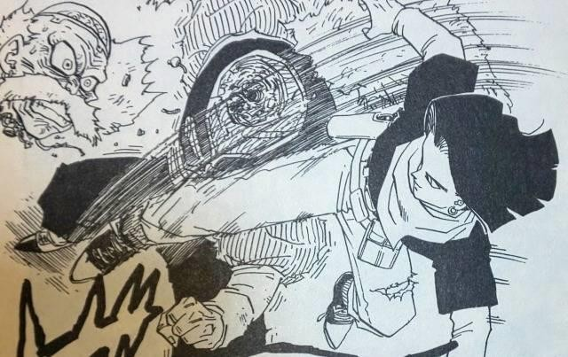
[C] No.4: Transformation to Cyborg of Dr. Gero
Dr. Gero manufactured Cyborg No.19 and ordered it to transform himself to a humanoid cyborg No.20 during the 3 years after the attempt of invasion by mechanical Frieza.
However, Dr. Gero chose the old-fashioned energy Absorbing style
of which battle power is much inferior to the perpetual energy style.
After all, he was terminated by No.17 who had
the perpetual power reactor.

Slide 25
[C] No.4: Transformation to Cyborg of Dr. Gero
It was wiser of Dr. Gero to have chosen the perpetual energy style,
wasn't it?

Slide 26
[C] No.4: Transformation to Cyborg of Dr. Gero
However…
Dr. Gero was super genuine who handled the latest mechatronics to biotechnology, but the only thing he was bad at was control of personality.
Actually, both of No.17 and 18 turned a deaf ear to his order at all, so he invented No.19 with the old-fashioned energy-absorbing style at the expense of greater battle power.
Also, No.19 was in charge of transformation of Dr. Gero to No.20, so No.19 could have been out of control and he failed to change to a cyborg if he had implemented the perpetual power reactor to No.19.
Even if Dr. Gero adopted the power reactor to himself, he would have failed to control his
own personality and lost his own mind.
Considering it, both of No.19 and 20(Dr. Gero) had no choice but to be manufactured with the old-fashioned style.

Slide 27
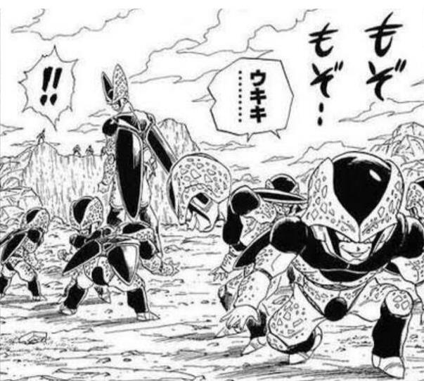
[A] No.5: The Number of Cell Jr.
In a scene of Cell Game, Cell born 7 children called Cell Jrs. for so that he tried to educe Gohan's incredible potential power by let his kids injure as many other Z fighters.
Cell born 7 children, but Gohan actually terminated as many as 8 Cell Jrs.
4
6
5
7
1
2
3

Slide 28
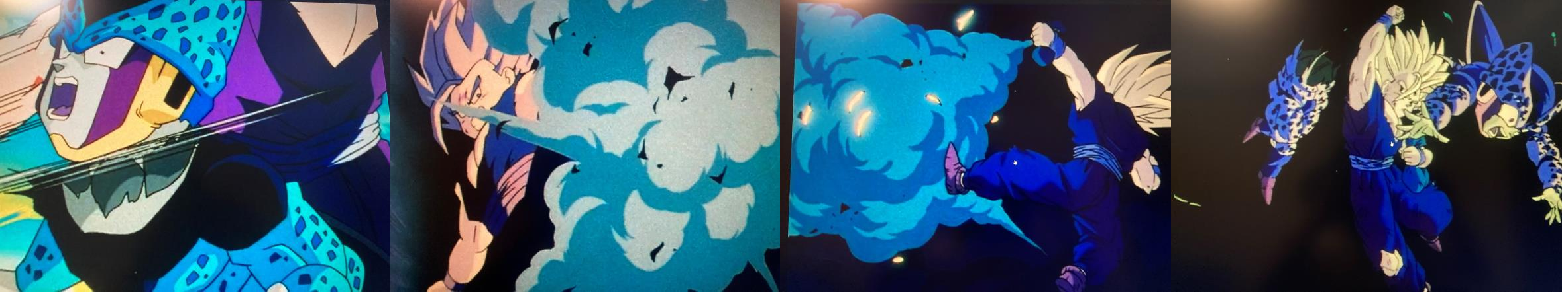
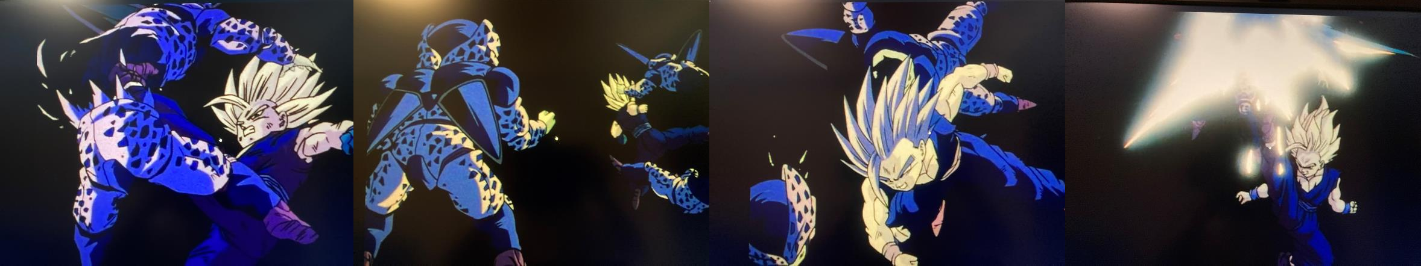
[A] No.5: The Number of Cell Jr.
1
2
3
4
5
6
7
8

Slide 29
[A] No.5: The Number of Cell Jr.
Where did the other show up?

Slide 30
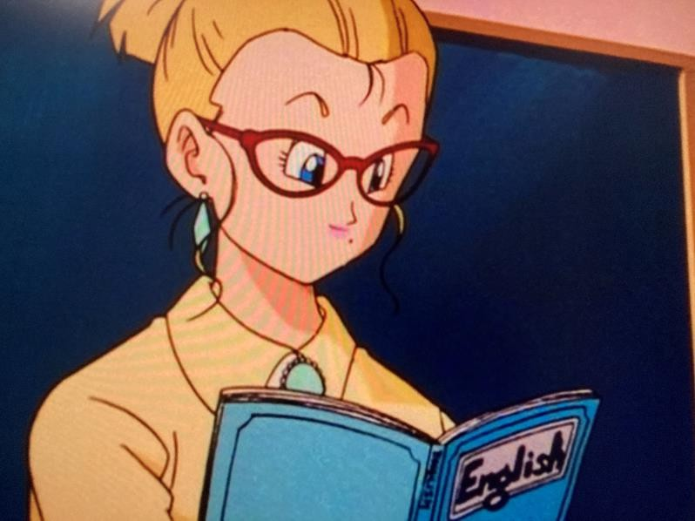
[A] No.6: An English Class in Orange Star High School
7 years after Cell Game, Gohan started his high school life at Orange Star High School, where he took an English class.
However, all character can make themselves understood in Japanese as a cosmopolitan language regardless of differences in species in the world of Dragon Ball.

Slide 31
[A] No.6: An English Class in Orange Star High School
Learning English makes no sense,
doesn't it?

Slide 32
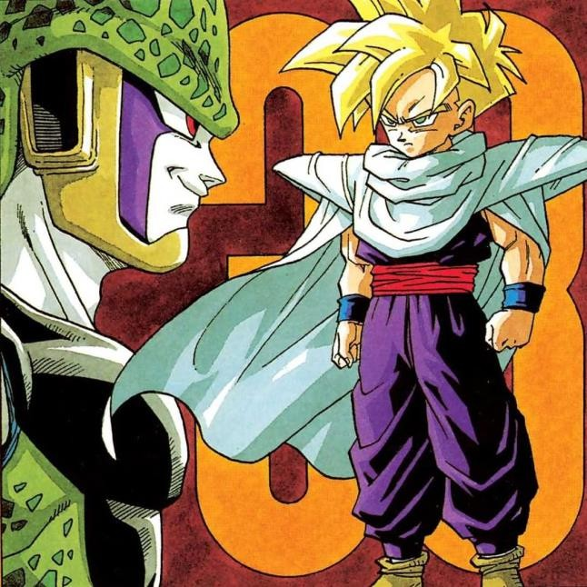
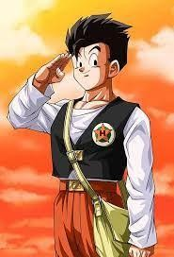
[C] No.7: Aging of Gohan
Gohan was 11 years old when Cell
Game was held.
When he fought against Majin Buu in 7 years, he had turned
16 years old.
'11 + 7 = 18', so he had to be 18.
In 7 years
11 years old
16 years old

Slide 33
[C] No.7: Aging of Gohan
？？？？？？？？？？？？？

Slide 34
3. Summary

Slide 35
3. Summary
Poor communication between the author and staff in the publication company and variable saying of the author himself brought loads of contradictions both in comics and anime.
It is more interesting than negative because there is space where readers can find
hidden fun and pleasure.
Also, Dragon Ball is a purely sophisticated work that vividly describes exciting battles and grown-ups can enjoy reading it.
All episodes in comics, anime version of Dragon Ball and Dragon Ball Z are fun!
(Some people are fans of Majin Buu episodes and other not, but I personally am.)

Slide 36
3. Summary
I have said a lot, but in short…
Dragon Ball is the Best!

Slide 37
EOD

